Slide 1



Predictive Maintenance
Using advance analytics on Machine Learning to monitor machine performance
What we Need?
What we Get?
downtime event
reduce downtime
machine active hour
extend machine life
parameters
optimize output
lower safety risks

Slide 2



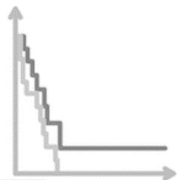

ML Solution
Data Collection
Data Ingest
Data Processing
Data Modelling
Data Visualization
Data(e.g sensor) shows equipment condition before, during and after downtime
Source:
- Diverse schema/formats
- Batch/Streaming
Big Data platform
Real Time Data Ingest
Analytics Tool
Identification features condition(e.g missing value,etc), Draw preliminary insight such as variable conditions when machine is down
Predict Downtime/failure
Calculate and predict probable events and schedule maintenance to analyze downtime
Visualize analytical results into dashboards and create alert system for monitoring

Slide 3
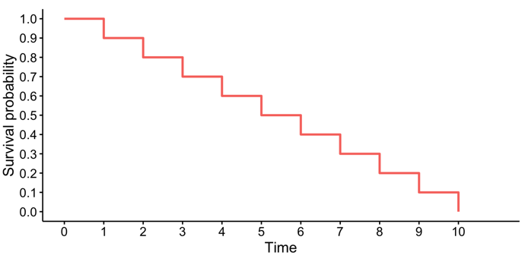

AIgorithm
The survival analysis method to predict possible production process disruptions consisting in machine failure and employing the obtained knowledge to provide robust production schedule
What was the chance of the thing survive for the past 20 months
What factors influence the specific event to occur
Kaplan Meier
ML Algorithm

Slide 4

Case
Evaluate downtime event of machines and overall performance by its parameters on Clinker Production
Clinker Production
Performance
Parameters
Preheater Stage 1
Preheater Stage 2
Preheater Stage 3
Preheater Stage 4
Calciner
Exit Gas Kiln
Exit Gas Preheater
Kiln
Burner
Cooler
Others
Up
1
2
3
Temp (°C)
Press (mBar)
Speed
4
Down
Running hour
Etc..
5
6

Slide 5
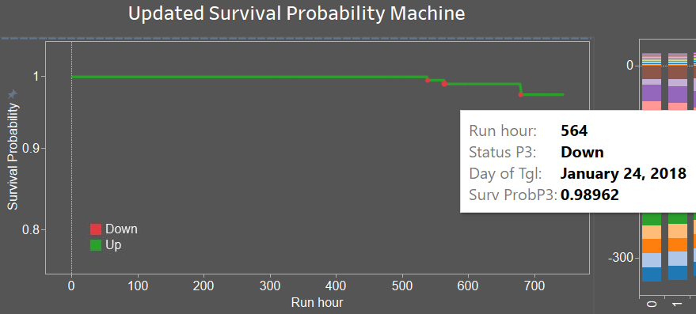
Results
Preheater Stage 3 Machine was down at 564 cumulative running hour, it yields 98.9% cumulative survival probability of machine on 24 January,2018

Slide 6
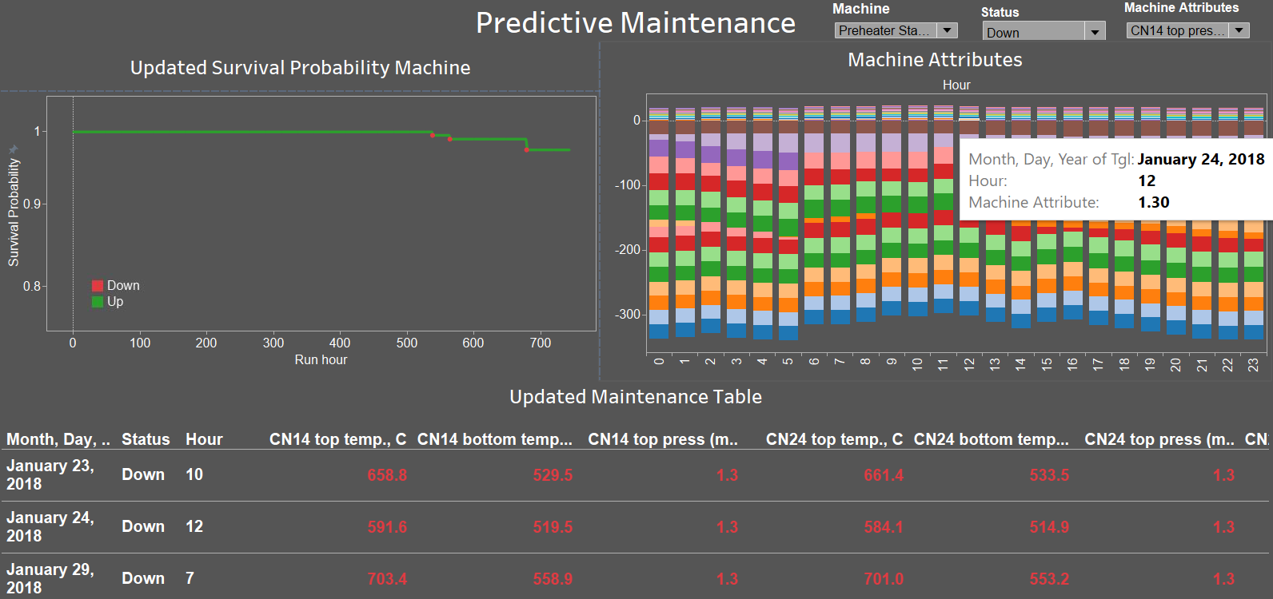
Results
Uncommon parameters value recorded when machine is down ( e.g : cn14 top press most common value fall in less than 0 when it’s up, while it’s 1.3 when machine is down)

